Slide 1
Chapter No. 04 – Cache Memory (Part – 02)
Lecture – 09
17-04-2018

Slide 2
Topics to Cover
4.3 Elements of Cache Design
Cache Addresses
Cache Size
Mapping Function
Types of Mapping
Replacement Algorithms
Write Policy
Line Size
Number of Caches

Slide 3
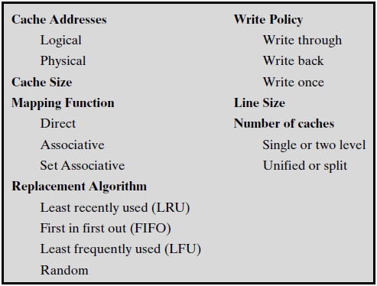
4.3 Elements of Cache Design (Table 4.2)
Although there are a large number of cache implementations, there are a few basic design elements that serve to classify and differentiate cache architectures. Table 4.2 below lists key elements.

Slide 4
Cache Size
We would like the size of the cache to be small enough so that the overall average cost per bit is close to that of main memory alone.
We would like the cache to be large enough (up to a point) so that the overall average access time is close to that of the cache alone.
It is observed, that the larger the cache, the larger the number of gates (bits) involved in addressing the cache.
The result is that large caches tend to be slower than the smaller ones
The available chip and board area also limits cache size.
The performance of cache is very sensitive to the nature of workload, so it is impossible to arrive at a single ‘optimum’ cache size.

Slide 5
Mapping Function
Why do we need mapping?
Because there are fewer cache lines than main memory blocks, an algorithm is needed for mapping main memory blocks into cache lines.
Further, a means is needed for determining which main memory block currently occupies a cache line.
Three mapping techniques can be used:
Direct 2. Associative 3. Set-Associative
The choice of mapping function dictates how the cache is organized.

Slide 6
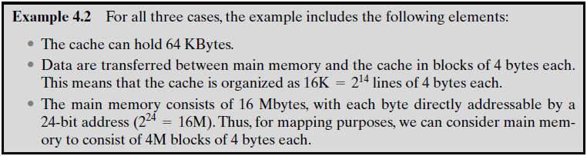
Example 4.2
We will examine each of these three mapping techniques. In each case, we look at the general structure and then a specific example.
(Capacity)

Slide 7
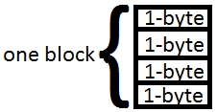
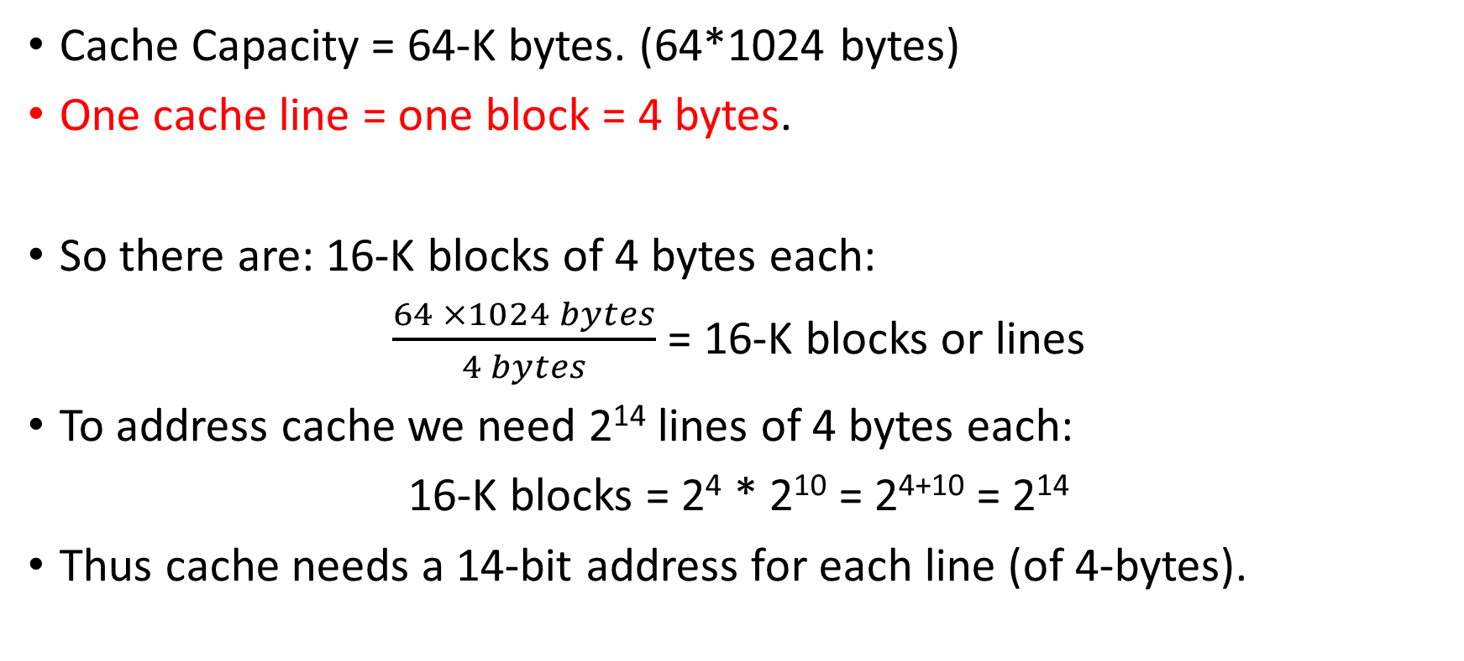
Example Explained (Cache)
Cache Capacity = 64-K bytes. (64*1024 bytes)
One cache line = one block = 4 bytes.
So there are: 16-K blocks of 4 bytes each:
$\frac{64 ×1024 bytes}{4 bytes}$ = 16-K blocks or lines
To address cache we need 2¹⁴ lines of 4 bytes each:
16-K blocks = 2⁴ * 2¹⁰ = 2⁴⁺¹⁰ = 2¹⁴
Thus cache needs a 14-bit address for each line (of 4-bytes).

Slide 8
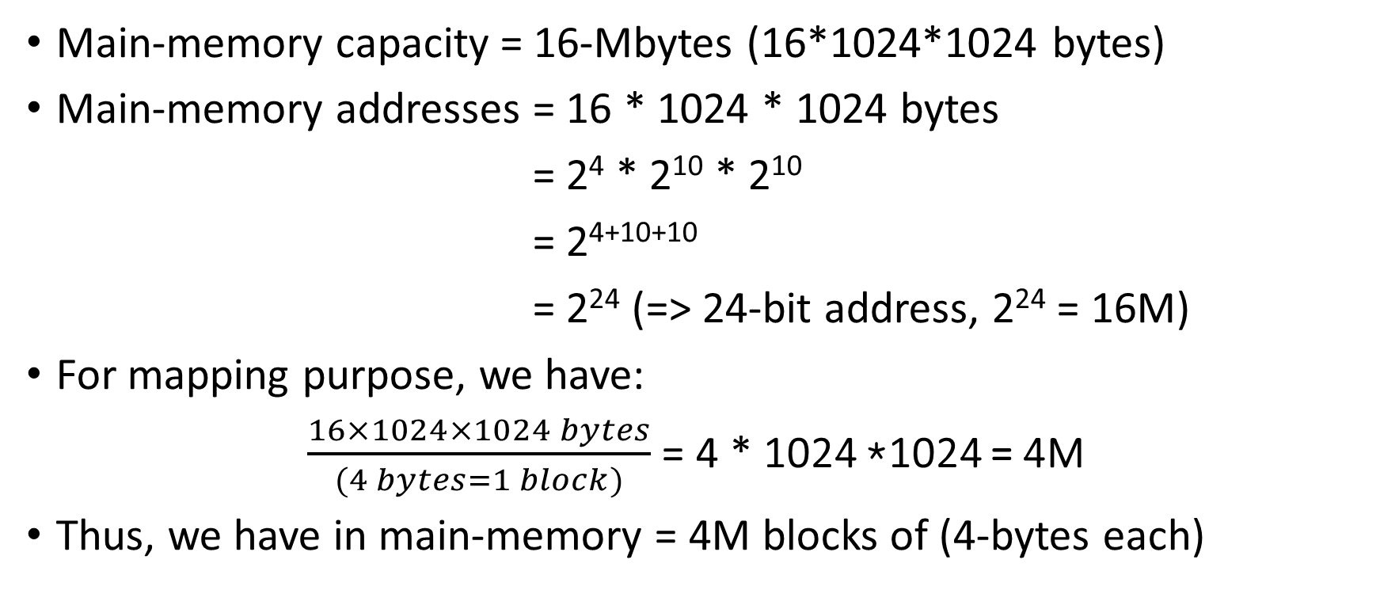
Example Explained (Memory)
Main-memory capacity = 16-Mbytes (16*1024*1024 bytes)
Main-memory addresses = 16 * 1024 * 1024 bytes
= 2⁴ * 2¹⁰ * 2¹⁰
= 2⁴⁺¹⁰⁺¹⁰
= 2²⁴ (=> 24-bit address, 2²⁴ = 16M)
For mapping purpose, we have:
$\frac{16×1024×1024 bytes}{(4 bytes=1 block)}$ = 4 * 1024 *1024 = 4M
Thus, we have in main-memory = 4M blocks of (4-bytes each)

Slide 9
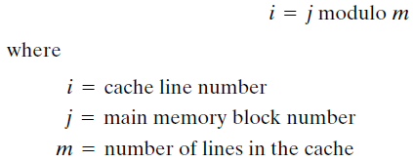
1. Direct Mapping
Direct mapping maps each block of main memory into only one possible cache line. (Slicing)
I.E. if a block is in cache, it must be in one specific place.
The ‘direct mapping’ is expressed as:
Modulus operator(%) returns remainder after integer division.

Slide 10
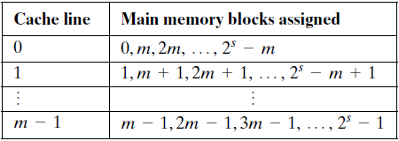
Direct Mapping
In ‘Direct Mapping’, the blocks of main-memory are assigned to lines of the cache as follows:
The use of a portion of the address (r-bits) as a line number provides a unique mapping of each block of main-memory into the cache.
(Tag field)

Slide 11
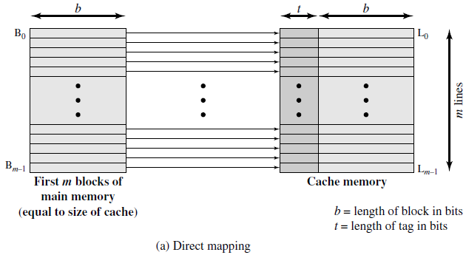
Figure shows the mapping for the first m-blocks of main memory.
Each block of main memory maps into one unique line of the cache.
The next m-blocks of main memory map into the cache in the same fashion; that is, block B_{m} of main memory maps into line L₀ of cache, block B_{m+1} maps into line L₁, and so on.

Slide 12
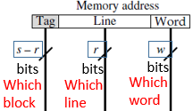
Direct Mapping (Figure Next Slide)
See ‘s-bits’
For purpose of cache access, each main-memory address can be viewed as consisting of three fields.
The least significant w-bits identify a unique word or byte within a block of main-memory. (The address is at the byte level)
The remaining s-bits specify one of the 2^{s}-blocks of main-memory.
The cache logic interprets these s-bits as a tag of s – r bits (most significant portion) and a line field of r-bits.
The ‘line field’ identifies one of the m = 2^{r} lines of the cache.

Slide 13
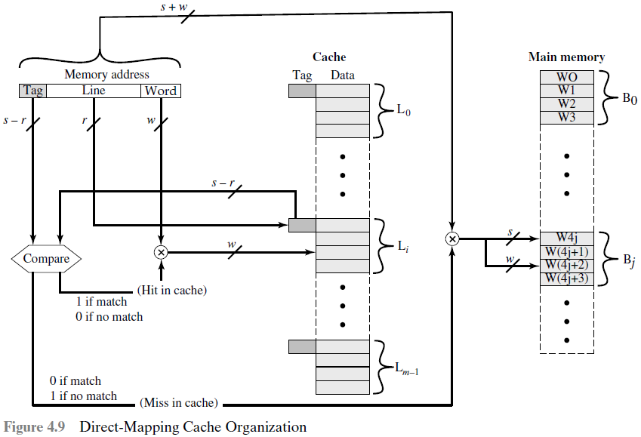
bits
Cache Access Logic
This square
Box contains
The answer to
Question 3.
(Block)
(Blocks)
bits
bits
bits
Which
block
Which
line
Which
word
Line
(04 -
Words)
(4-words
per block)

Slide 14
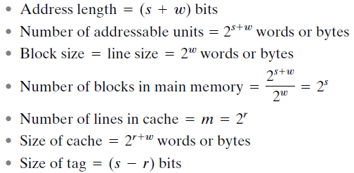

Summary of ‘Direct Mapping’
Where s is the number of blocks of main-memory and w is a word.
In main-memory
e.g. w =2-bits specifies 4-words in that block
(Blocks * words) / words = blocks
r bits specify m lines of the cache
Cache capacity = lines * words per line = r + w bits
Note: Tag distinguishes a block from other blocks that can fit into that line.
(s –r) - bits
r - bits
w

Slide 15
Advantages and Disadvantages (Direct Mapping)
Advantages
The direct mapping technique is simple and inexpensive to implement
Disadvantage
Its main ‘disadvantage’ is that there is a fixed cache location for any given block.
Thus, if a program happens to reference words repeatedly from two different blocks that map into the same line, ‘cache misses’ are HIGH.
Then the blocks will be continuously swapped in the cache, and a hit ratio will be low, this phenomenon is known as thrashing.

Slide 16
Victim Cache
One approach to lower the miss penalty is to remember what was discarded in case it is needed again.
Since the discarded data has already been fetched, it can be used again at a small cost.
Such recycling is possible using a ‘Victim cache’.
‘Victim cache’ was originally proposed as an approach to reduce the conflict misses of direct mapped caches without affecting its fast access time.
Victim cache is a fully associative cache, whose size is typically 4 to 16 cache lines, residing between a direct mapped L1 cache and memory.

Slide 17
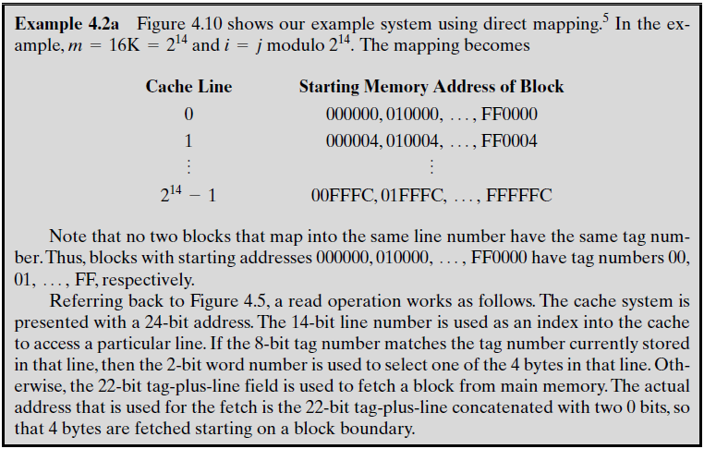
Example 4.2(a)
8-bits
r-bits specify m lines
2
Spacing = 4 bytes
Tag (8-bits)
Tag specifies which memory block is placed in the cache line
Each block has
4-byte word

Slide 18
For Example
Tag s-r
Line or Slot r
Word w
24 bit address
2 bit word identifier (4 byte block)
22 bit block identifier (s – r + r)
8 bit tag (=22-14)
14 bit slot or line
No two blocks in the same line have the same Tag field
Check contents of cache by finding line and checking Tag
8
14
2

Slide 19
Cache Read Operation (Example)
Tag (s - r)
Line or Slot r
Word w
8
14
2
The cache system is presented with a 24-bit address.
The 14-bit line number is used as an index into the cache to access a particular line. (containing 4 bytes/words)
If the 8-bit tag number (is found), matches the tag number currently stored in that line, then the 2-bit word number is used to select one of the 4 bytes in that line.
Otherwise (if not found), the 22-bit tag-plus-line field is used to fetch a block from main memory.
The actual address that is used for the fetch is the 22-bit tag-plus-line concatenated with two 0-bits, so that 4 bytes (2² = 4) are fetched starting on a block boundary.
(Break)

Slide 20
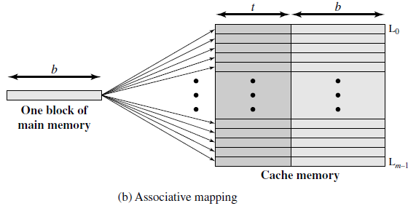
2. Associative Mapping
Associative mapping permits each main-memory block to be loaded into any line of the cache.

Slide 21
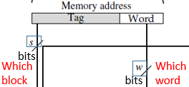

Fully Associative Cache Organization (Fig. Next)
The ‘cache control logic’ interprets a memory address simply as a Tag and a Word field.
The Tag field uniquely identifies a block of main-memory. M = 2^{n}/K blk
To determine whether a block is in the cache, the ‘cache control logic’ must simultaneously examine every line’s tag for a match.
Note that no field in the address corresponds to the line number ‘r’, so that the number of lines in the cache is not determined by the address format.
= 2^{S}
Block identify bits
w

Slide 22
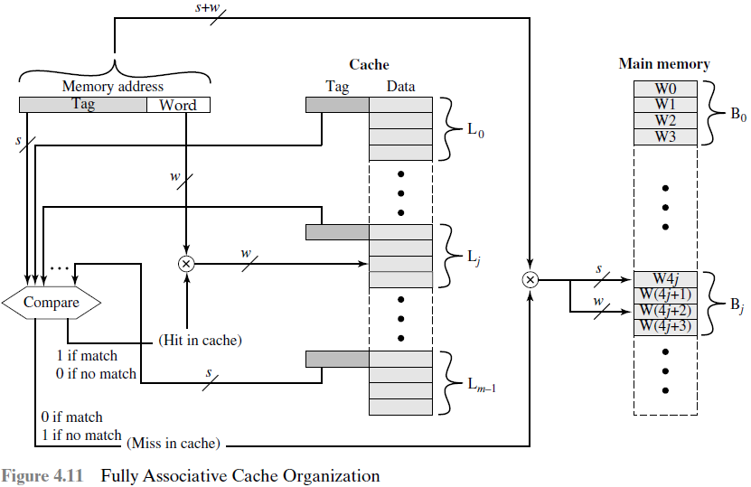
Cache Access Logic
(Block)
(Blocks)
bits
Which
block
Which
word
bits
This square
Box contains
The answer to
Question 4.
Line
(04 -
Words)
(4-words
per block)

Slide 23
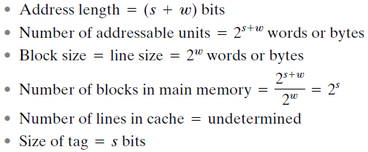
Summary of ‘Associative Mapping’
Block of main memory = s, no. of words in each block = w
In main-memory
e.g. 2² = 4 bytes
(Blocks * words) / words = blocks
That is why we have NO r-bits in address
Tag distinguishes a block of main memory
Block identify bits
w

Slide 24
Advantages and Disadvantages (Associative Mapping)
Advantages
With ‘Associative mapping’, there is flexibility as to which block to replace when a new block is read into the cache.
Replacement algorithms, help to decide which line to replace and are designed to maximize the HIT-ratio.
Disadvantage
The principal disadvantage of ‘associative mapping’ is the complex circuitry required to examine the tags of all cache lines in parallel.
This means that ‘cache searching gets expensive’.

Slide 25
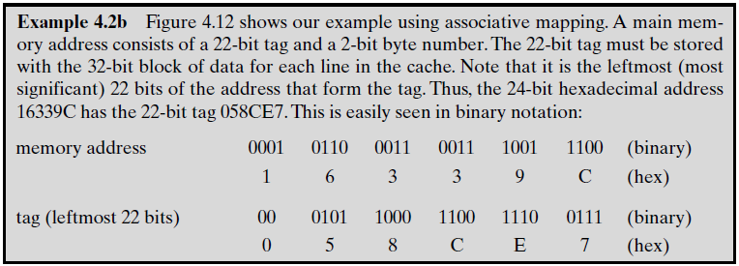
Example 4.2 (b)
2 bits removed
(24 bits)
S-bits
w
We have 4M blocks in Main-memory => 4*1024*1024 = 2²⁺¹⁰⁺¹⁰ = 2²² =>22-bits

Slide 26
For Example
Word
2 bit
22 bit tag stored with each 32 bit block of data
Compare tag field with tag entry in cache to check for hit
Least significant 2 bits of address identify which 8 bit word is required from 32 bit data block
e.g.
Address Tag Data Cache line
16339C 058CE7 24682468 3FFF
Tag 22 bit

Slide 27
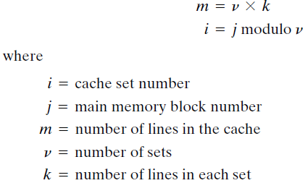
3. Set-Associative Mapping
Set-Associative mapping, each block maps into all the cache lines in a specific set, so that main-memory block B₀ maps into set 0, and so on.
The cache consists of a number of sets (v), each of which consists of a number of lines (k). The relationships are
(out of V-sets)
(K-way ‘Set-Associative’)

Slide 28
K-way Set-Associative Mapping (Fig. Next)
With k-lines per set, this is referred to as k-way set-associative mapping.
With set-associative mapping, block B_{j} can be mapped into any of the lines of set-j.
Thus set-associative cache can be implemented as v-associative cache
E.g. in a ‘2-way set-associative mapping’ (having 2 lines per set), a given block can be in one of the two-lines in any one set.
Figure (next slide) illustrates this mapping for the first v blocks of main-memory.

Slide 29
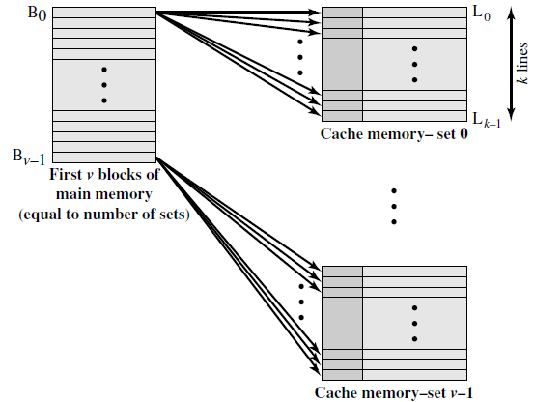
‘V’ Associated–Mapped Caches
V-sets
K-lines per set
Each V-set is ASSOCIATIVE
Block B₀ fits into any line of set-0

Slide 30
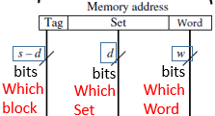
Set-Associative ‘Cache Control Logic’
For ‘Set-Associative mapping’, the cache control logic interprets a memory address as three fields: Tag, Set, and Word.
The d bits specify one of v = 2^{d} sets.
The s bits of the Tag and Set fields specify one of the 2^{s} blocks of main-memory.
Advantage: With ‘k-way set-associative mapping’, the tag in a memory address is much smaller and is only compared to the k tags within a single set. (whereas associative-mapping tag is large, and compared with all lines).
Figure (next slide) illustrates the ‘cache control logic’.

Slide 31
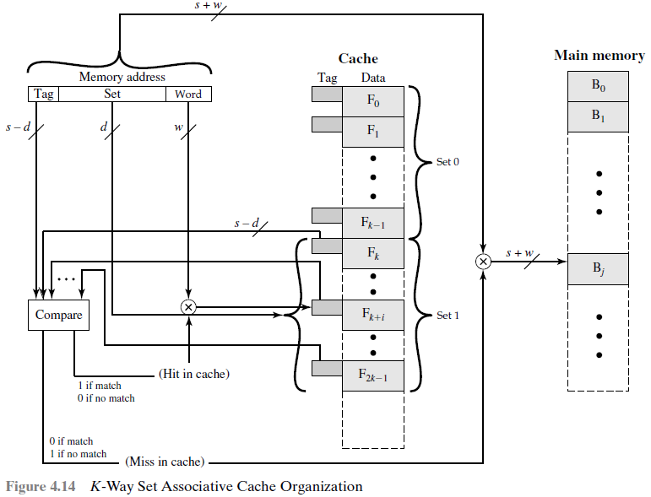
Cache Access Logic
This square
Box contains
The answer to
Question 5.
bits
bits
bits
Which
block
Which
Set
Which
Word
k-lines
Block B_{j}
Goes to set-j
k-lines

Slide 32
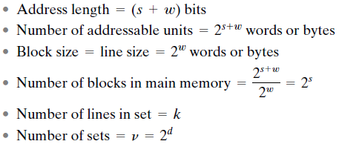

Summary of ‘Set-Associative Mapping’
Block of main memory = s, no. of words in each block = w
In main-memory
e.g. 2² = 4 bytes
(Blocks * words) / words = blocks
d-bits to identify v-sets
k lines per v sets
No. of lines (k)ⅹ No. of sets (v) * No. of words (w)

Slide 33
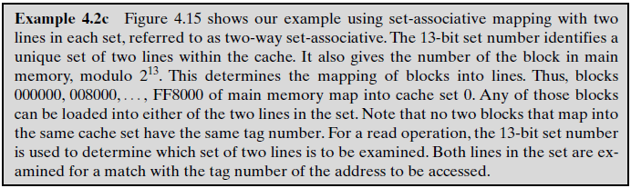
Example 4.2 (c)
In a ‘2-way set-associative mapping’ (having 2 lines per set), a given block can be in one of the two-lines in any one set.
13 bit set number (identifies a unique set of two lines within the cache). Block number in main memory is modulo 2¹³

Slide 34
For Example (Cache Read)
Use set field to determine cache set to look in
Compare tag field to see if we have a hit
e.g
Address Tag Data Set number
1FF 7FFC 1FF 12345678 1FFF
001 7FFC 001 11223344 1FFF
Word
2 bit
Tag 9 bit
Set 13 bit

Slide 35
Set-Associative Mapping (Extreme Cases)
In the extreme case of v = m, k =1, the set-associative technique reduces to direct-mapping.
For v =1, k = m, it reduces to associative-mapping.
The use of two-lines per set (v = m/2 for k = 2) is the most common ‘set-associative’ organization.
It significantly improves the HIT-ratio over ‘direct-mapping’.
‘Four-way set-associative’ (v = m/4, k = 4) makes a modest additional improvement. Further increase in No. of lines per set has little effect.

Slide 36
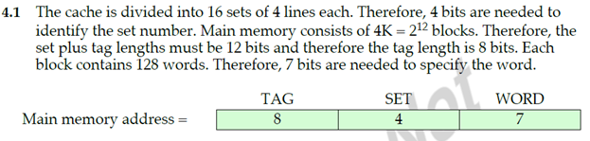
Problem 4-1
See Last Questions
(Answer)

Slide 37
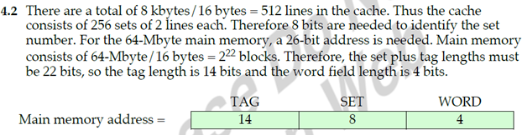
Problem 4-2
(Answer)

Slide 38
Summary of Three Mapping Techniques
Mapping Type | Address Length (bits) | No. of Addressable Units (words /bytes) | Block Size /Line Size (words /bytes) | No. of Blocks in Main-memory | No. of Lines in Cache (m) | Size of Cache (words) | Tag Size (bits)
Direct | ( s + w ) | 2 ^ ( s+ w) | 2 ^ w | 2 ^ s | 2 ^ r (lines) | 2 ^ ( r + w) | ( s – r )
Associative | ( s + w ) | 2 ^ ( s+ w) | 2 ^ w | 2 ^ s | undefined | unknown | s-bits
Set-Associative | ( s + w ) | 2 ^ ( s+ w) | 2 ^ w | 2 ^ s | k-lines per set | k * v * w (v = sets) | ( s – d )
This is the difference in all 3 techniques
Note: 2 ^ w means 2^{w}
(Break)

Slide 39
Cache ‘Replacement Algorithms’ (Associative)
Once the cache has been filled, when a new block is brought into the cache, one of the existing blocks must be replaced.
For direct-mapping, there is only one possible line for a particular block, and no choice is possible. We have to replace that line (thrash).
For the associative and set-associative techniques, a replacement algorithm is needed.
To achieve high speed, such an algorithm must be implemented in hardware.
A number of algorithms have been tried. We mention only four.

Slide 40
Types of ‘Cache Replacement Algorithms’
Four of the most common cache replacement algorithms are:
Least Recently Used (LRU)
First-In-First-Out (FIFO)
Least Frequently Used (LFU)
Random Replacement (RR)
‘Least Recently Used (LRU)’ is the most effective and popular replacement algorithm.

Slide 41
Types of ‘Cache Replacement Algorithms’
Least Recently Used (LRU): Replace that block in the set that has been in the cache longest with no reference to it. (relates to time)
We are assuming that more recently used memory locations are likely to be referenced again. This is called ‘Temporal locality’ and it should give the best HIT-ratio.
The cache mechanism maintains a separate list of indexes to all the lines in the associative cache.
When a line is referenced, it moves to the front of the list.
For replacement, the line at the back of the list is used (discarded).

Slide 42
Types of ‘Cache Replacement Algorithms’
First-In-First-Out (FIFO): Replace that block in the set that has been in the cache longest. (first-come first-serve pattern)
FIFO is easily implemented as a round-robin or circular buffer technique.
Least Frequently Used (LFU): Replace that block in the set that has experienced the fewest references. (relates to the use of data item)
LFU could be implemented by associating a counter with each line.
Random Replacement (RR): Pick and replace a line at random from among the candidate lines.

Slide 43
Write Policy
Coherency property: States that if a Word or a cache line (block) is modified in the lower level memory M1 (cache), then copies of that word must be updated immediately at all higher memory levels M2, M3 and so on, so as to maintain ‘data coherency’ among different memory levels.
When a block that is resident in the cache is to be replaced, if it has not been altered (updated/overwritten), then it may directly be replaced without first writing out this block to the main memory.
If at least one write operation has been performed on a word in that line of the cache, then main memory must be updated by writing that block to the main memory before bringing in the new block in cache.

Slide 44
Types of ‘Write Policies’
If a Word has been altered only in the cache, then the corresponding memory Word is invalid.
If the I/O device has altered the main-memory, then the cache Word is invalid.
To maintain ‘data coherency’, two write policies have been adopted:
Write through 2) Write back

Slide 45
Types of ‘Write Policies’
Write through: Using this technique, all write operations are made to main memory as well as to the cache simultaneously, ensuring that main-memory is always valid. (Advantage)
‘Write through’ does an ‘immediate update’ in RAM whenever a word is modified in cache.
Its main disadvantage, it generates ‘memory traffic’ and bottleneck.
Write back: Minimizes memory writes, and it ‘delays an update’ in main-memory until that updated block is being replaced by a new block in that same line in the cache. (set ‘updated’ bit for a line)
Before ‘write back’, the main-memory block is invalid (Disadvantage).

Slide 46
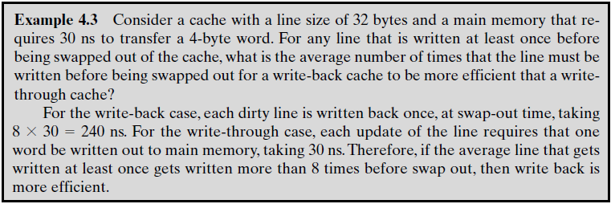
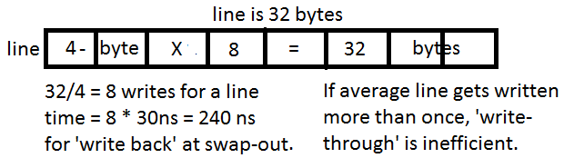
Example 4.3
Answer:

Slide 47
Line Size
When a block of data is retrieved and placed in the cache, not only the desired word but also some number of adjacent words are retrieved. (a block is a combination of words)
As the block size increases, the hit ratio will at first increase, due to:
Principal of locality, which states that data in the vicinity of a referenced word are likely to be referenced in the near future.
As the block size increases further, the hit ratio will begin to decrease.
The relationship between block size and hit ratio is complex, and no definitive optimum value has been found. 8-to-64 bytes is reasonable.

Slide 48
Number of Caches
Multilevel Caches / Cache Hierarchy
On-chip cache (L1): is a cache on the same chip as the processor.
The ‘on-chip cache (Level-1)’ reduces the processor’s external bus activity and therefore speeds up execution times and increases overall system performance. It is often accessed in one cycle by CPU.
An off-chip cache (L2) is external to the processor and is designated as Level-2. It is made of static-RAM (SRAM).
Due to the slow bus speed and slow memory access time, resulting in poor performance, an L2 cache is desirable & gives ‘zero-wait state’.

Slide 49
L2 cache uses a separate data path (Local bus), so as to reduce the burden on the ‘system bus’.
With the continued shrinking of the processor components (due to Moore’s law), a number of processors now incorporate the L2 cache on the processors chip, improving performance.
A Hit is counted if the desired data appears in either the L1 or the L2 cache.
L2 has little effect on the total number of cache hits until it is at least double the L1 cache size.
With the increasing availability of on-chip area available for cache, most microprocessors have moved the L2 cache on the processor chip and added an L3 cache (Off chip).
The L3 cache is accessible over the external bus and gives a performance advantage to adding the third level.
Cache size should be double.

Slide 50
‘Unified’ Versus ‘Split Caches’
The on-chip cache first consisted of a single cache used to store references to both data and instructions.
Now it has become common to split the cache into two: one dedicated to instruction and one dedicated to data, called split cache.
These two caches both exist at same level, typically as two L1 caches.
When the processor attempts to fetch an ‘instruction/data’ from main-memory, it first consults the ‘instruction/data’ L1 cache.
Unified cache has only one cache that is used for holding both data and instructions.

Slide 51
Advantages of a ‘Unified Cache’
There are two potential advantages of a unified cache over split cache:
For a given cache size, a unified cache has a higher hit rate than split caches because it balances the load between instruction and data fetches automatically.
That is if an execution pattern involves many more instruction fetches than data fetches, then the cache will tend to fill up with instructions, and if an execution pattern involves relatively more data fetches, the opposite will occur.
Only one cache needs to be designed and implemented.

Slide 52
Advantages of a ‘Split Cache’
The key advantage of the split cache design is that it eliminates contention for the cache between the instruction fetch/decode unit and the execution unit. (useful for ‘pipelining’ of instructions)
This enables the processor to fetch instructions ahead of time and fill a buffer, or pipeline, with instructions to be executed.
The trend is toward split caches at the L1 and unified caches for higher levels.

Slide 53
‘Spatial’ & ‘Temporal’ LOCALITY (Q 4.8 = Q12)
Principal of locality, which states that data in the vicinity of a referenced word are likely to be referenced in the near future.
The ‘principal of locality’ has two types:
Spatial locality 2) Temporal locality
Spatial locality: refers to the tendency of execution to involve a number of memory locations that are clustered. This means to ‘access neighbouring info items whose addresses are near one another’. Space locality.
Temporal locality: refers to the tendency for a processor to access memory locations that have been used recently. So the item that has a ‘probability of being used in future is kept’. (so don’t discard it) locality in time.

Slide 54
Preparatory Questions
Quiz # 2
Chapter #4
Q1. Why do we need ‘cache mapping’ techniques? What are the types of mapping? (Slide – 05)
Q2. What are the differences among ‘direct mapping, associative mapping and set-associative mapping’? (Slide 9, 20 and 27)
Q3. For a ‘direct-mapped cache’, a main-memory address is viewed as consisting of three fields. List and define the three fields. (Slide – 13.Box, Attached Q5. Answer below)
Q4. For an ‘associative cache’, a main-memory address is viewed as consisting of two fields. List and define the two fields. (Slide – 22.Box, Attached Q6. Answer below)
Q5. For a ‘set-associative cache’, a main-memory address is viewed as consisting of three fields. List and define the three fields. (Slide – 31.Box, Attached Q7. Answer below)

Slide 55
Preparatory Questions
Q6. Write down the advantages and disadvantages of ‘direct mapping’. (Slide – 15)
Q7. Write down the advantages and disadvantages of ‘associative mapping’. (Slide – 24)
Q8. Write down the two ‘Extreme cases’ of ‘set-associative mapping’. (Slide – 35)
Q9. List and explain the various ‘replacement algorithms’ used in cache memory. (Slide – 39, 40, 41 and 42)
Q10. What is ‘data coherency’? To maintain data-coherency which two ‘write policies’ are adopted in caches? Explain. (Slide 43, 44 and 45)
Q11. State the advantages of ‘unified cache’ over ‘split cache’, and vice versa. (Slide – 51)
Q12. What is the distinction between ‘spatial locality’ and ‘temporal locality’? (Slide – 53)

Slide 56
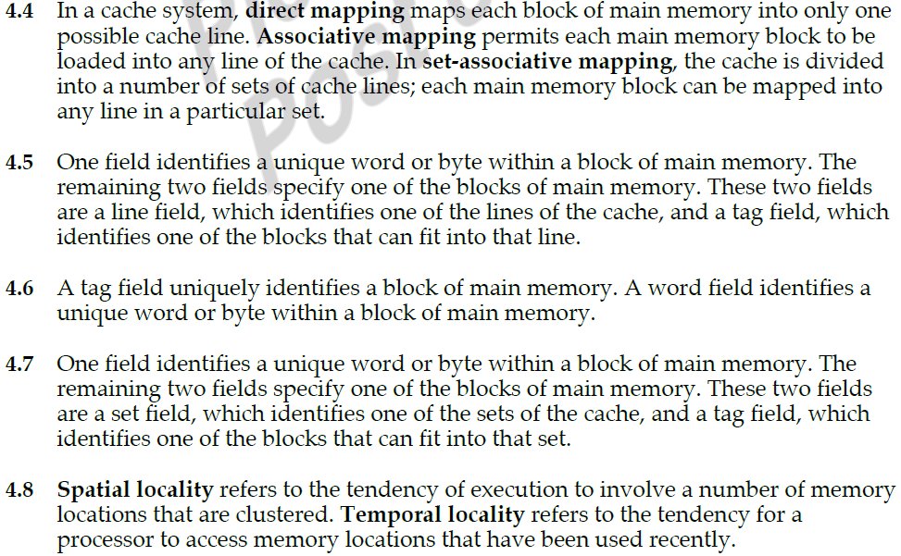
Answers to Guess Questions: Q2. (4.4), Q3. (4.5), Q4. (4.6), Q5. (4.7), Q12. (4.8) below:

Slide 57
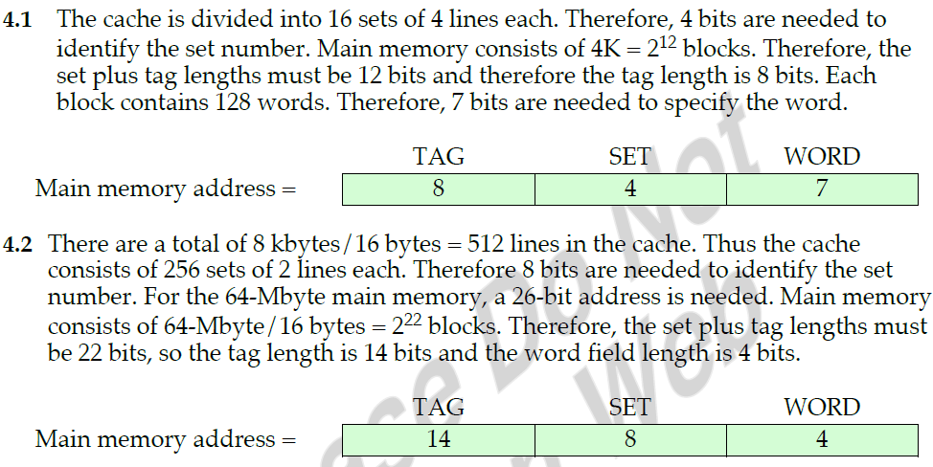
Answers to Problems 4.1 and 4.2 below.

Slide 58
For Information
Problems 4.1 & 4.2 are part of your course.
Examples 4.1, are part of your course.
Preparatory Questions are provided for this chapter.

Slide 59
Cache Addresses
Out of Course
Can be of two types
Logical addressing 2) Physical addressing
Almost all processors support ‘Virtual Memory’.
Virtual memory is a facility that allows programs to address memory locations higher than the processor’s addressing space from a logical point of view, without regard to the amount of main memory physically available. (This concept will be discussed in Chapter 8)
Memory Management Unit (MMU) is a hardware unit that translates each virtual address into a physical address in main memory, to allow reads and writes to main memory.

Slide 60
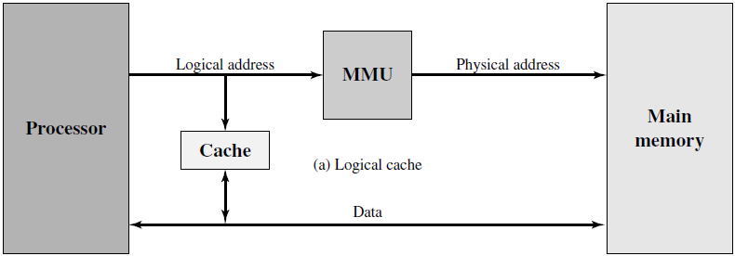
Logical and Physical Caches
Logical cache, also known as virtual cache, stores data using virtual addresses.
One obvious advantage of the logical cache is that ‘the processor accesses the cache directly, without going through the MMU’. So the cache access speed is faster than for a physical cache. Because the cache can respond before the MMU performs an ‘address translation’.
The disadvantage is that most virtual memory systems supply each application with the same virtual memory address that starts at 0. Thus cache memory must be completely flushed for two applications.
Physical cache stores data using main memory physical addresses.
Thus. the same virtual address in two different applications refers to two different physical addresses.

